Slide 1

Ten tips from using the ABAP Programming Model for SAP Fiori on AnyDB
DX134
John Patterson | @jasper_07

Slide 2

Costing too much
too long
work
Transformation
Our Fiori adoption

Slide 3
Costing too much
too long
work
Transformation
Costing too much

Slide 4
Costing too much
too long
work
Transformation
Taking too long

Slide 5
Costing too much
too long
work
Transformation
Hard to find resources

Slide 6
Costing too much
too long
work
Transformation
Can’t keep up with demand

Slide 7
Costing too much
too long
work
Transformation
Need more developers to upskill

Slide 8

You go to war with the developers you have
bennylin0724

Slide 9
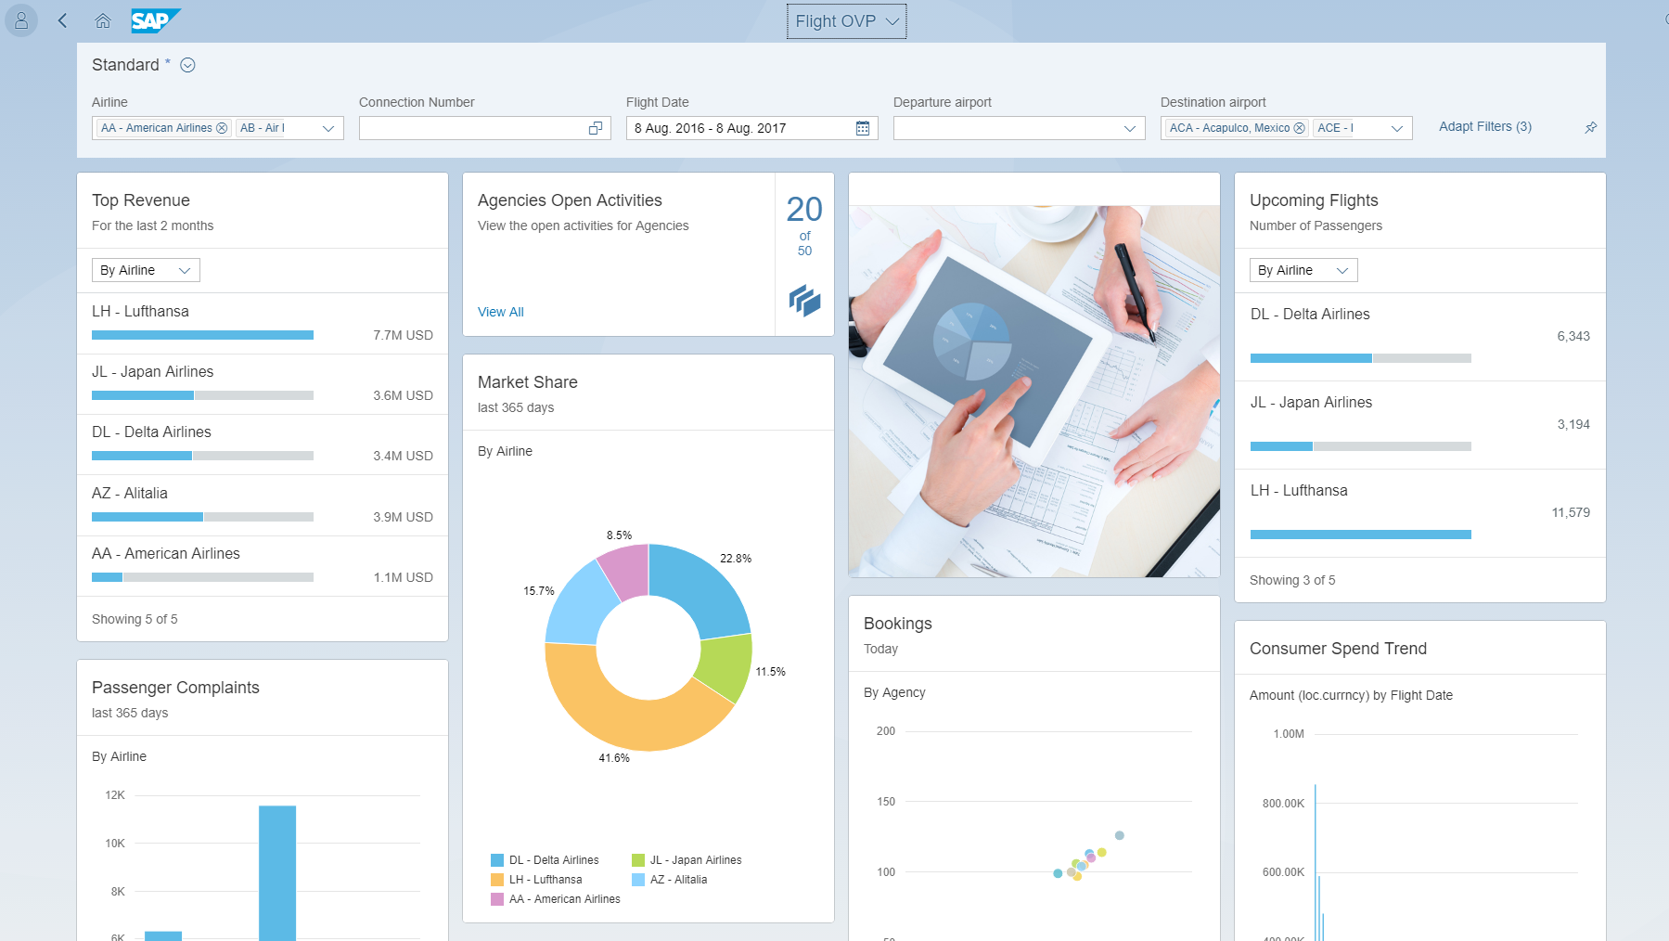
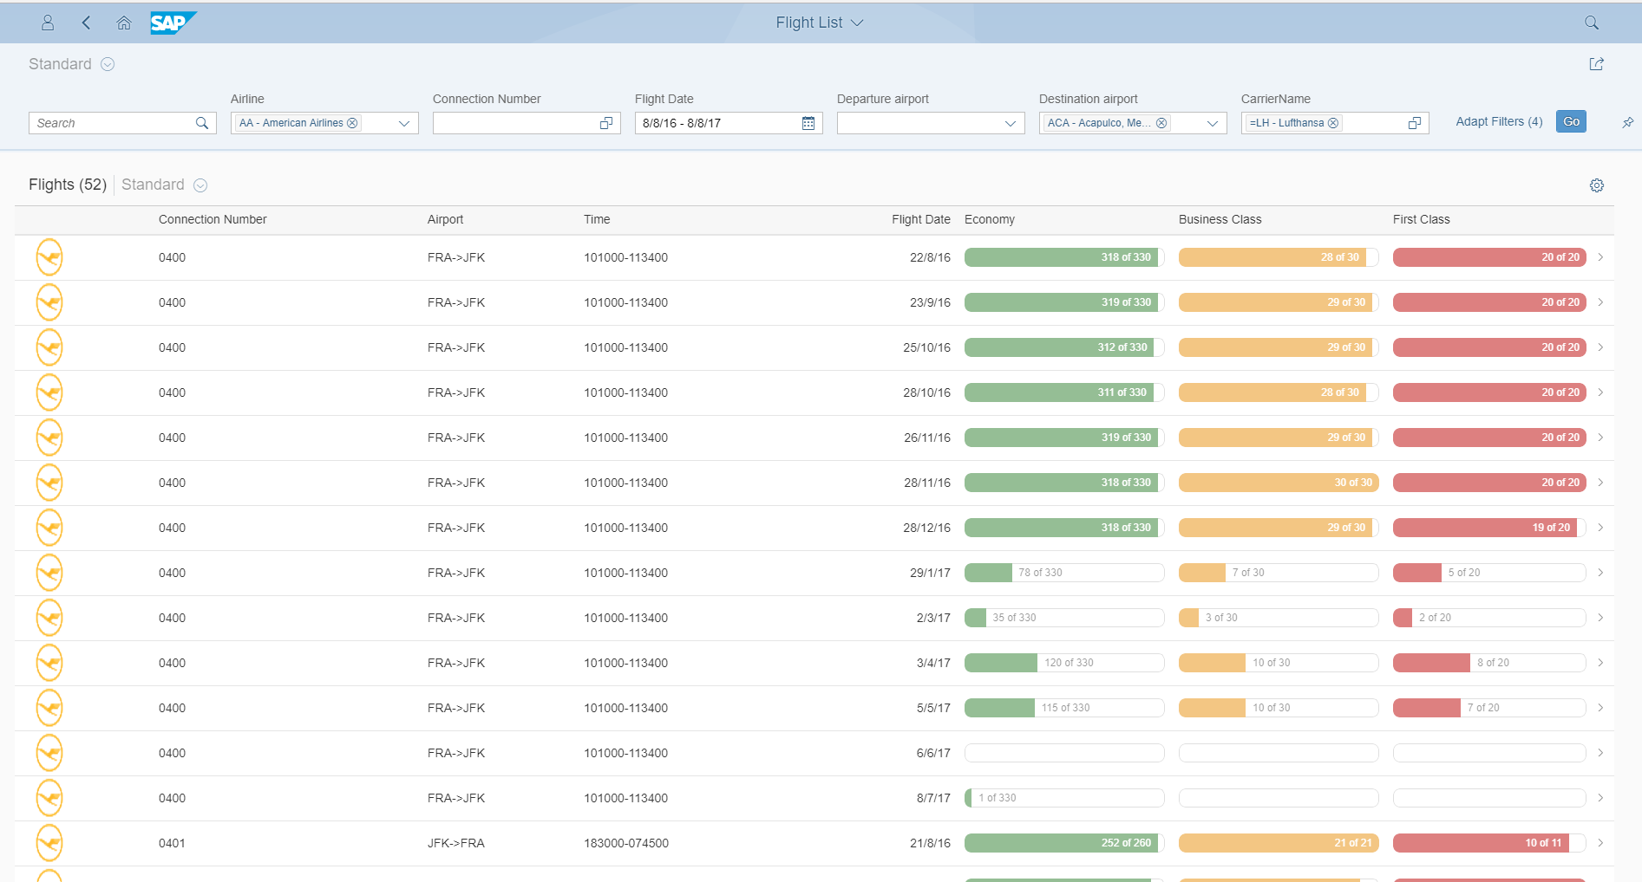
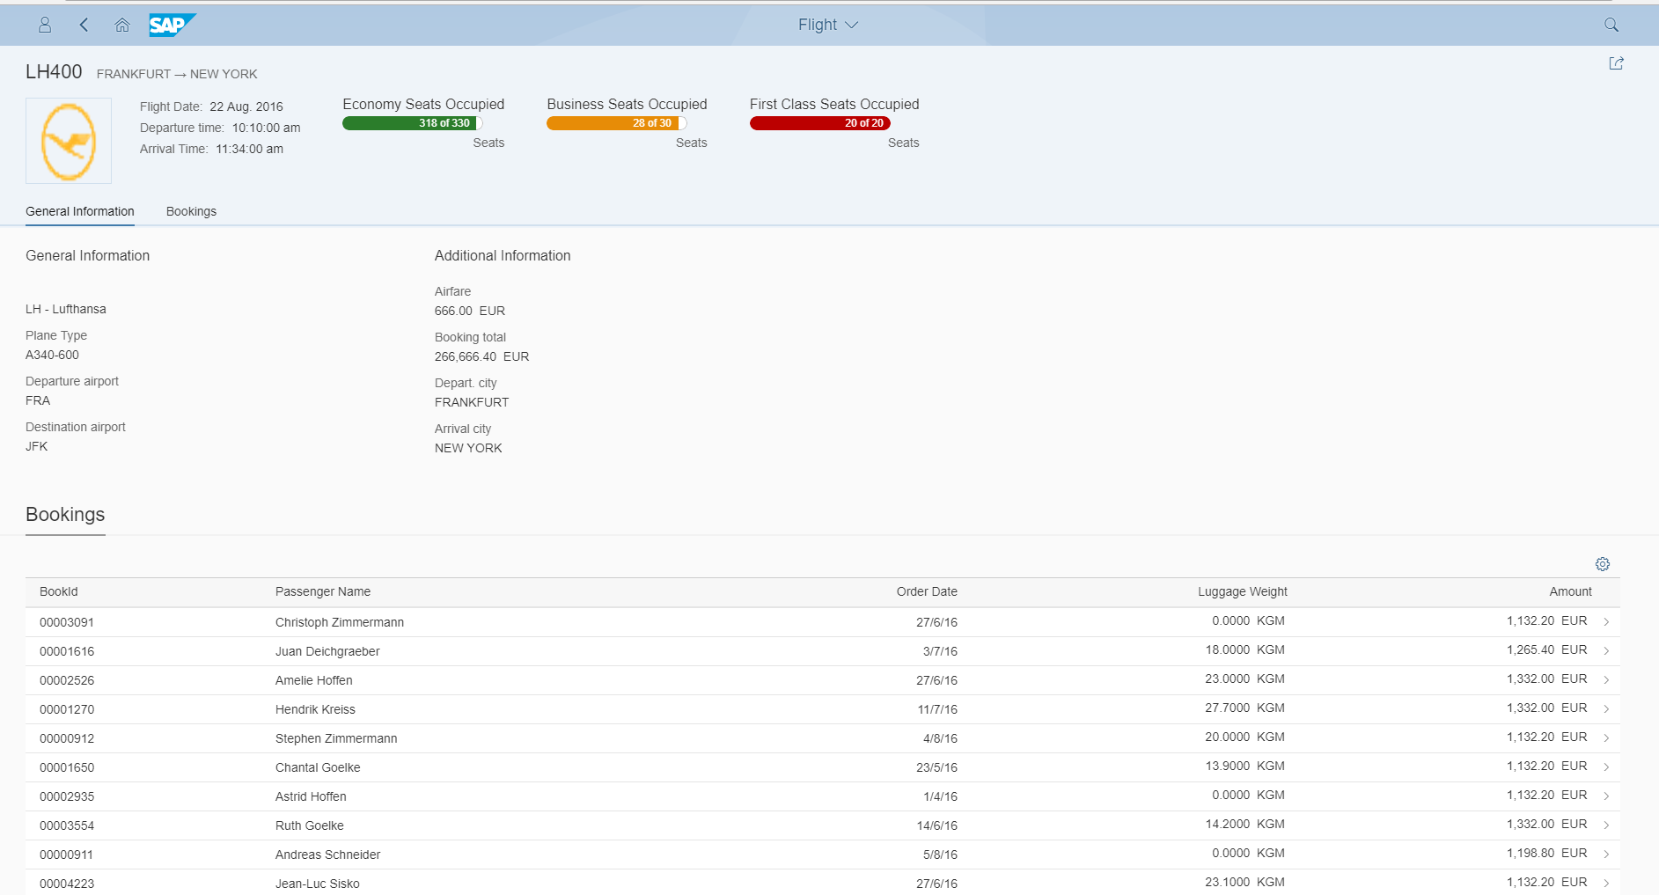
Fiori Elements
Metadata-Driven Uis based on CDS Annotations
Overview Page
List Report
Object Page

Slide 10
The Fiori Triangle
Efficiency
Scope
Fiori
Elements
Fiori Elements + Breakouts
Freestyle SAPUI5 apps
Resources
Time
Flexibility
@jasper_07

Slide 11

Limitations
CDS on AnyDB
Performance issues
No Fuzzy search
Work arounds
Fiori Elements
Steeper than expected learning curve
WebIDE wizard missing key features
Breakouts very restricted Extension API
@jasper_07
haru__q

Slide 12
Get access to a system with examples
1
Working examples really reduce the learning curve
@jasper_07

Slide 13
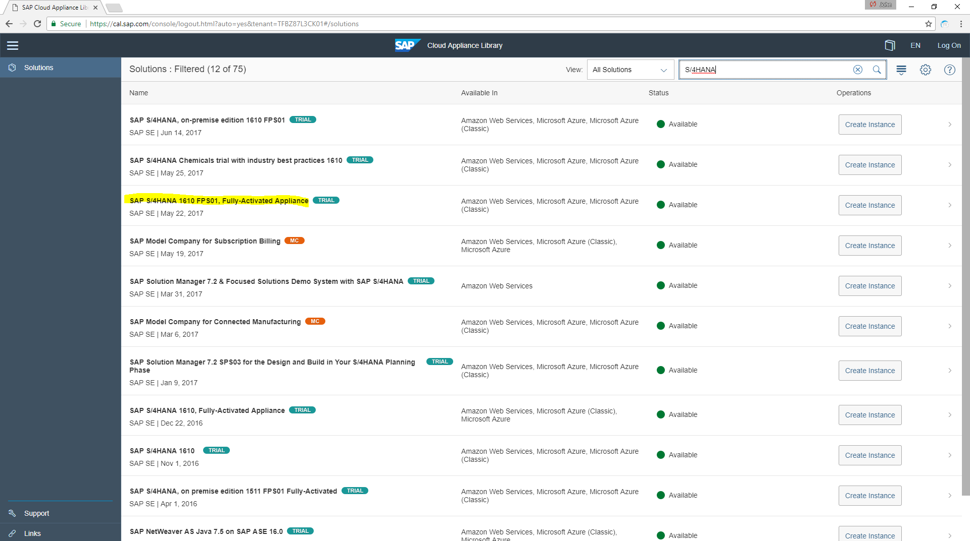

Slide 14
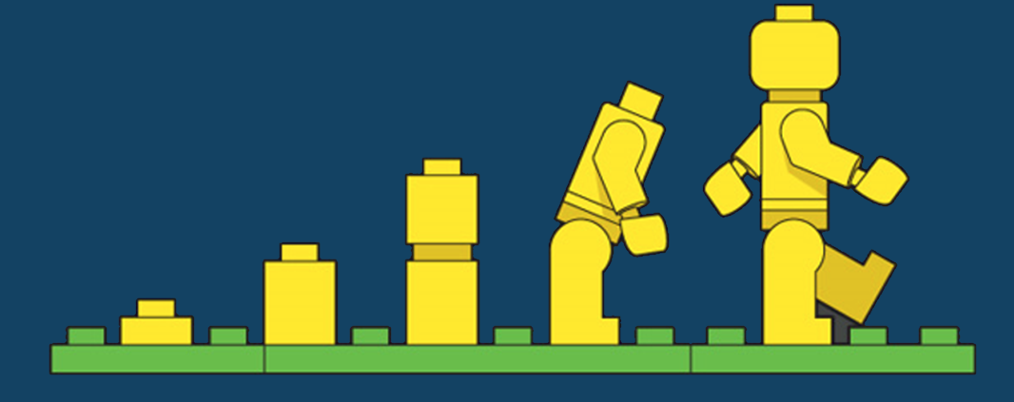
Start building up your own library of examples
2
@jasper_07
GlenNZ

Slide 15
Generating OData Services
Via CDS Annotation @OData.publish
1
Via SEGW using CDS Referenced Data Source
2
Via SEGW using Mapped Data Source
3
EXPOSE
ENRICH
ENHANCE

Slide 16
When to use
@OData.publish?
3
Generates a single root entity with associations. Ideal for List Report and Object Page
@jasper_07

Slide 17
Structure CDS views like SAP
4
Fiori UI
HTTPS
Consumption Views
Domain specific views
Help define end user layouts
OData Service
Definition of core entities
Simple projection of DB table
Exposure of all business data
Interface Views
Private Views
Technical helper views
Not part of the public/external interface
Physical Tables
@jasper_07
Notes:
Build

Slide 18
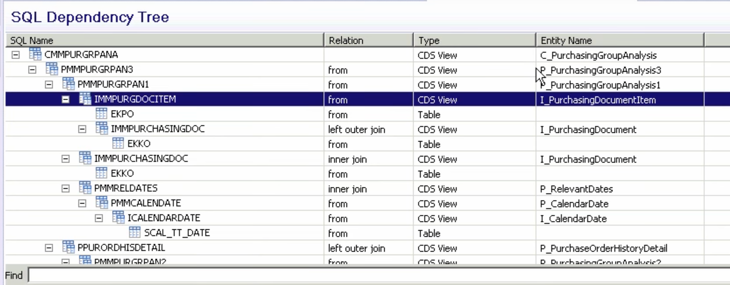
Views on Views
Consumption View “C”
Private View “P”
Interface View “I”
Database table
Notes:
Interface views (private) or basic views talk to the raw database tables
Consumption views (public) are views exposed as OData services, don’t talk direct to DB
Intermediate views are between Consumption and Basic views

Slide 19
Open SQL vs Native SQL
5
Analyze how CDS on HANA works to bridge the gaps in AnyDB
@jasper_07

Slide 20
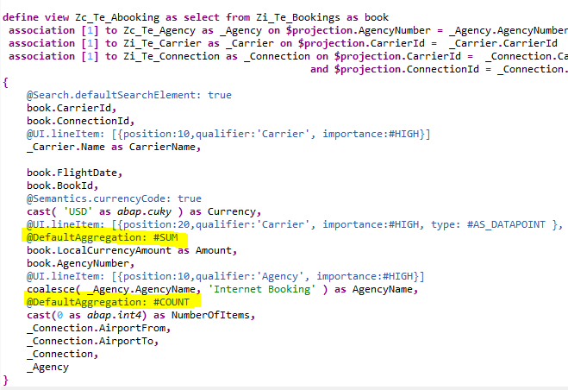
Aggregate Example
Open SQL will want to ‘group by’ all non-aggregate fields = SELECT fields + the KEY fields
That doesn’t work!! KEY is unique
Trick don’t use KEY fields, let CDS populate a locally generated KEY
Learnt from observing HANA XS and Analytical views

Slide 21
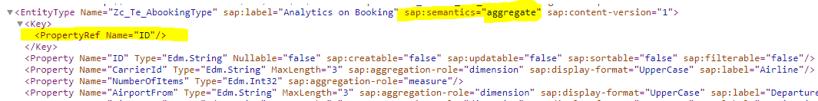
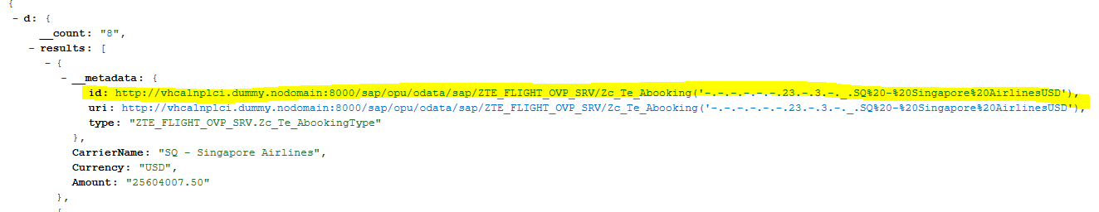
Automagic KEY
Zc_Te_Abooking?$top=5&$orderby=Amount desc&$select=CarrierName,Currency,Amount

Slide 22
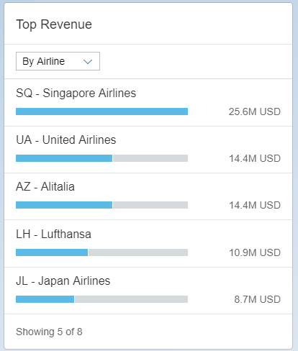
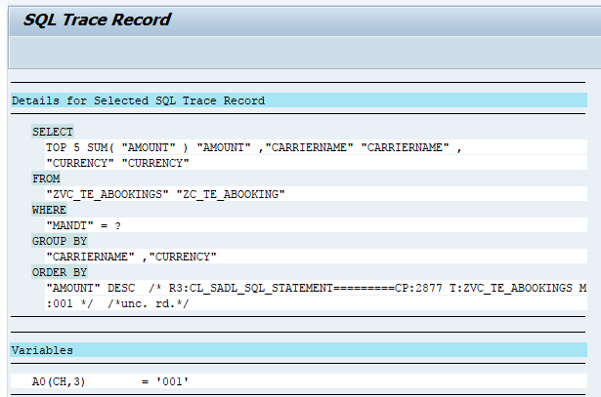
Simple Effective and Reusable

Slide 23
When to use
SEGW & CDS Reference?
6
Need multiple root entities, like an OVP or need to add additional metadata, enrich query results or mix CDS with classic Gateway
@jasper_07

Slide 24
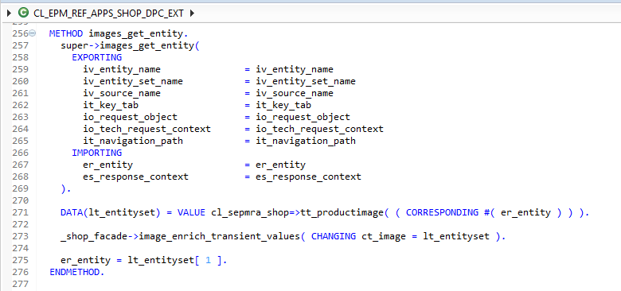
Enrich returned values

Slide 25
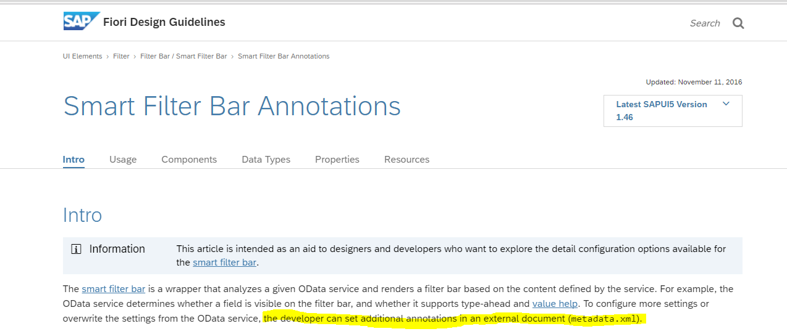
Know your Smart Controls
7

Slide 26
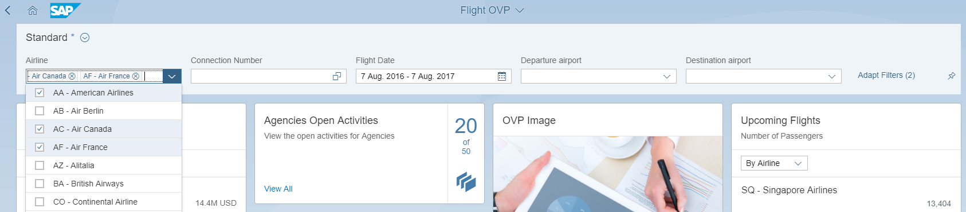
Smart Control Example
1
3
2
1. Smart Filter Bar
2. Multi Select Fixed Value
3. Interval value

Slide 27
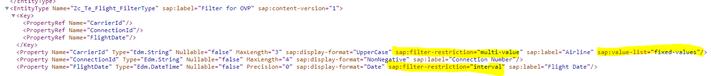
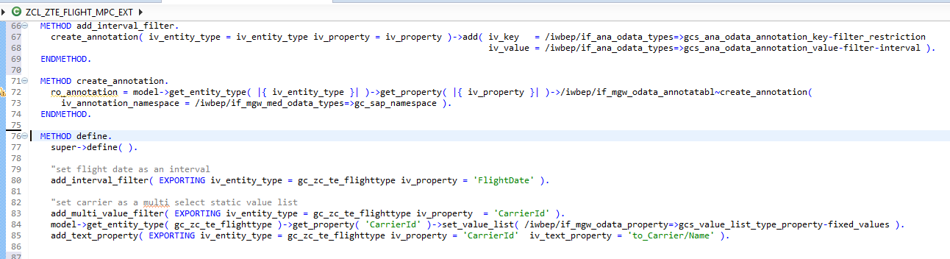


Smart Control Example
1
2
3
3
1
2

Slide 28
When to use SEGW & Mapped data source?
8
More complex scenarios, you want to dynamically change the behavior or inject additional logic into a query
@jasper_07
Notes:
Eg add custom filters, add parameters, chagnd

Slide 29
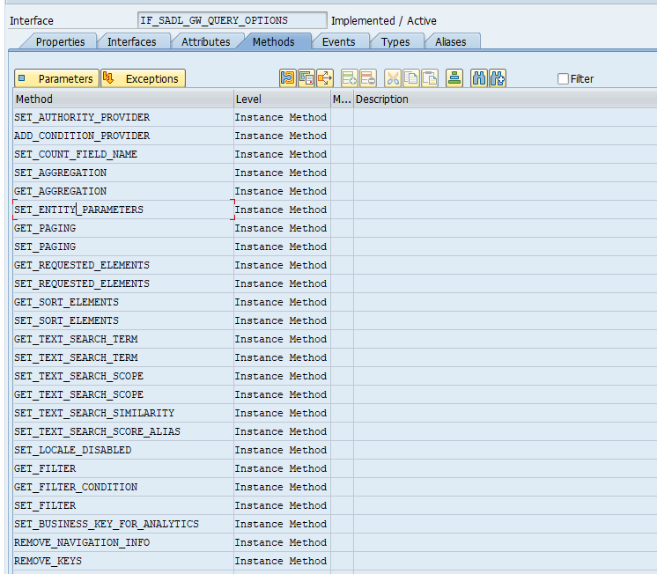
Query Options
Set search fields
Add additional sort criteria
Define additional field selection
Add additional filter criteria
Define aggregates and groups
Set parameters
Change navigation behavior

Slide 30
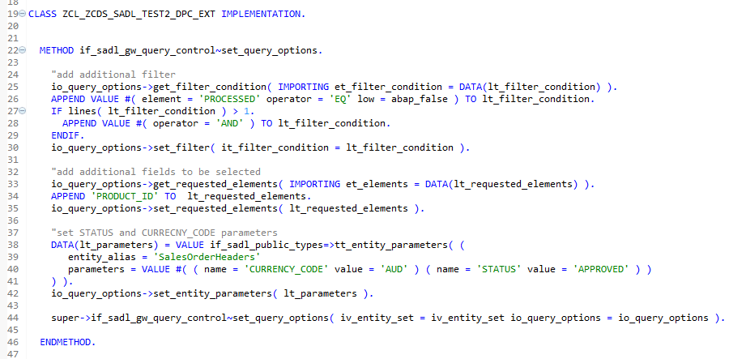
Query Options Example

Slide 31
Breakout
9
Good examples hidden in the SAPUI5 SDK, WebIDE wizard has limitations, know when to walk away
@jasper_07

Slide 32
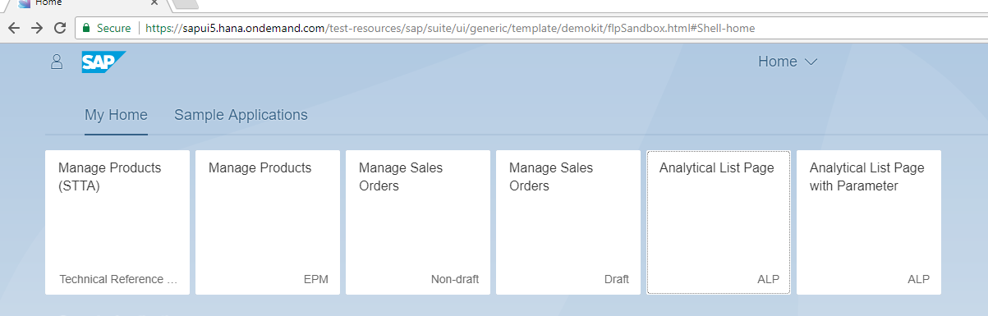
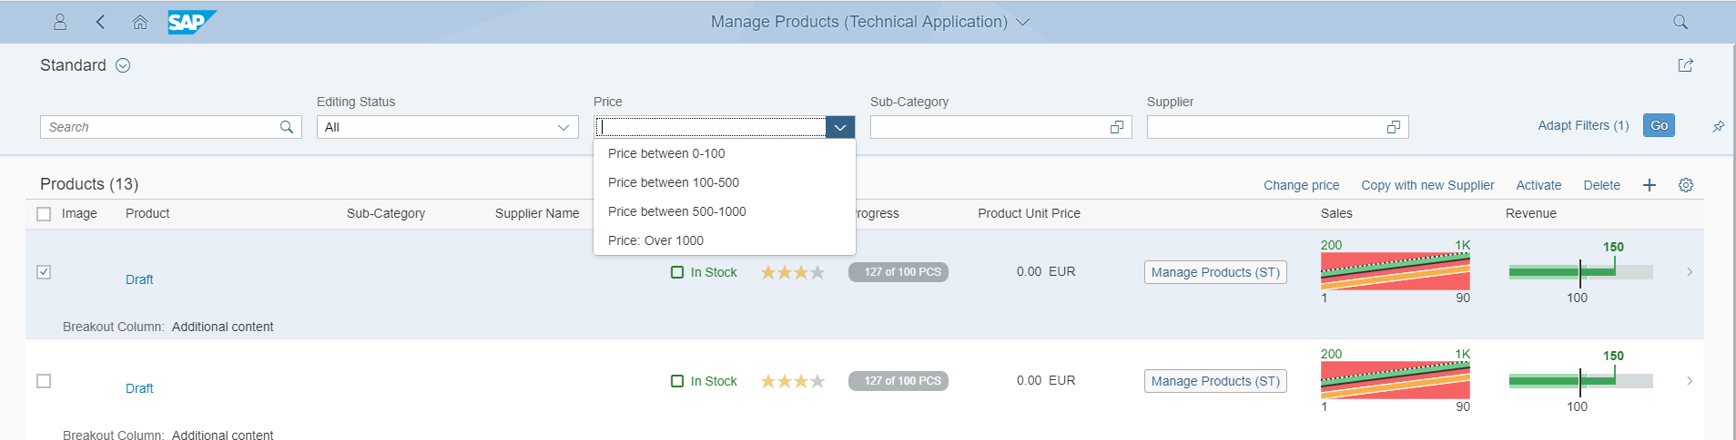
Breakout Example
2
4
5
6
3
1

Slide 33
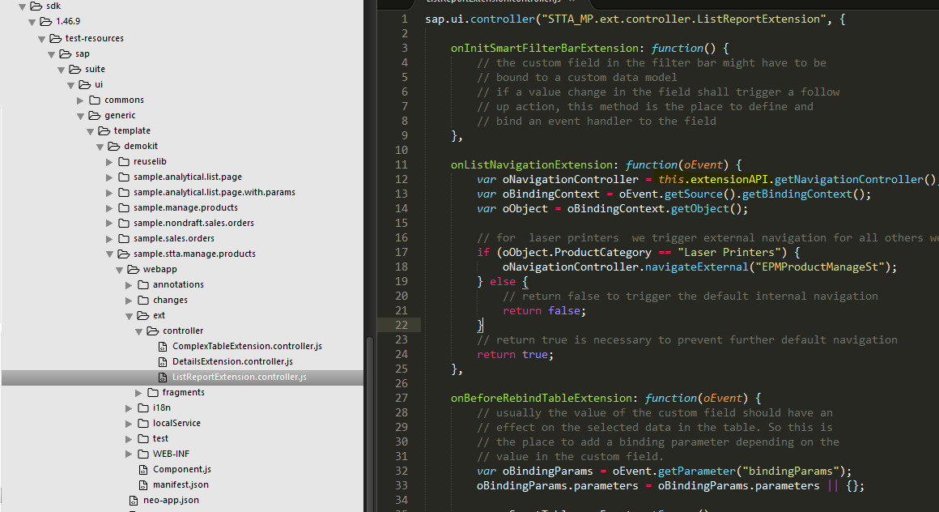

Slide 34
10
Fiori Elements and Build.me
Great for rapid prototyping Fiori Elements, but don’t assume the generated code is reusable
@jasper_07

Slide 35
Takeaways
1
One size doesn’t fit all
2
Need to get access to working
Fiori Elements can be used to help solve scaling problems
3
Need to find examples and create own examples

Slide 36

Give something back to the community

Slide 37
FEEDBACK
Please complete a session evaluation for this session!
DX134
John Patterson | @jasper_07

Slide 38
Links
Code from talk - github.com/jasper07/Teched17
SAPUI5 SDK - Fiori Elements Reference Apps
Fiori Design Guidelines - Smart Table
Generating an OData Service Based on a CDS View
Fine-Tuning the Execution of SADL-Based Gateway Services
The Semantically Rich Data Model – An ABAP based CDS Views example
My CDS view self study tutorial

